Slide 1
DATA STRUCTURES AND ALGORITHMS
SLIDE 9

Slide 2
Infix, Postfix and Prefix
Infix, Postfix and Prefix notations are three different but equivalent ways of writing expressions.

Slide 3
Infix Notation:
The traditional method of our writing of mathematical expressions is called as the infix expressions.
It is of the form <operand><operator><operand>.
As the name suggests, here the operator is fixed inside between the operands. e.g. A+B here the plus operator is placed inside between the two operators, (A*B)/Q.

Slide 4
Prefix: An expression is called the prefix expression if the operator appears in the expression before the operands. Simply of the form (operator operand1 operand2). Example : *+AB-CD (Infix : (A+B) * (C-D) )
Postfix: An expression is called the postfix expression if the operator appears in the expression after the operands. Simply of the form (operand1 operand2 operator). Example : AB+CD-* (Infix : (A+B * (C-D) )

Slide 5
During processing, a computer uses prefix or postfix expression to execute data.
REASON
In the infix expressions, it is difficult to keep track of the operator precedence whereas here the postfix expression itself determines the precedence of operators (which is done by the placement of operators)i.e the operator which occurs first operates on the operand.
Infix expression are easy to understand and evaluate for human beings. However computer finds it difficult to parse - Information is needed about operator precedence and associativity rules, and brackets which override these rules.
Hence we have postfix and prefix notations which make the computer take less effort to solve the problem.

Slide 6
Sr.No. | Infix Notation | Prefix Notation | Postfix Notation
1 | a + b | + a b | a b +
2 | (a + b) ∗ c | ∗ + a b c | a b + c ∗
3 | a ∗ (b + c) | ∗ a + b c | a b c + ∗
4 | a / b + c / d | + / a b / c d | a b / c d / +
5 | (a + b) ∗ (c + d) | ∗ + a b + c d | a b + c d + ∗
6 | ((a + b) ∗ c) - d | - ∗ + a b c d | a b + c ∗ d -

Slide 8
Postfix Evaluation Algorithm
We shall now look at the algorithm on how to evaluate postfix notation −
Step 1 − scan the expression from left to right Step 2 − if it is an operand push it to stack
Step 3 − if it is an operator pull operand from stack and perform operation
Step 4 − store the output of step 3, back to stack Step 5 − scan the expression until all operands are consumed
Step 6 − pop the stack and perform operation

Slide 9
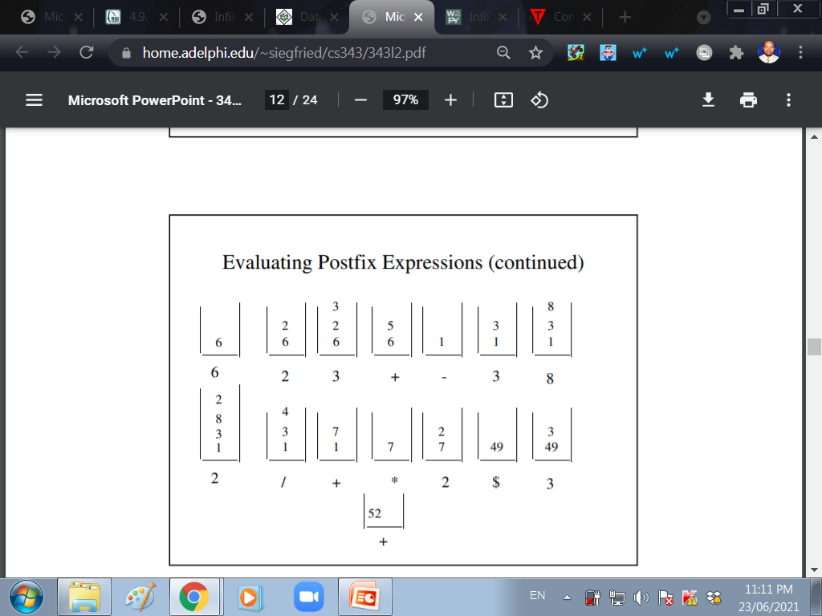
Use the algorithm to evaluate: 6 2 3 + - 3 8 2 / + * 2 $ 3 +

Slide 10
A prefix expression works entirely in same manner as the postfix expression.
While evaluating a prefix expression, the operators are applied to the operands immediately on the right of the operator.

Slide 11
Evaluation of Prefix Expression
Step 1 − scan the expression from left to right
Step 2 − if it is an operand push it to stack
Step 3 − for any TWO consecutive operands pull operator before them from stack and perform operation
Step 4 − store the output of step 3, back to stack
Step 5 − scan the expression until all operands are consumed
Step 6 − pop the stack and perform operation

Slide 13
BINARY EXPRESSION TREE
A binary expression tree is a specific kind of a binary tree used to represent expressions.
Two common types of expressions that a binary expression tree can represent are algebraic and boolean

Slide 14
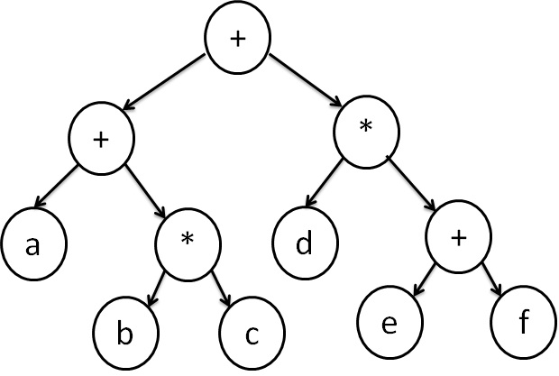
a + (b * c) + d * (e + f)
NB: In a binary expression tree, all the leafs are operands, whilst the rest of the nodes are operators

Slide 15
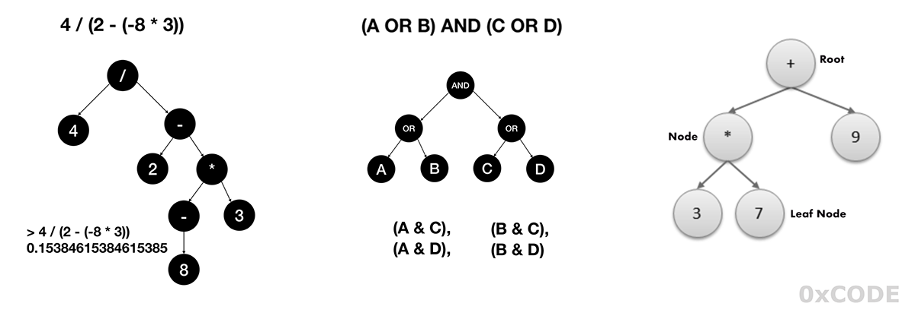

Slide 16
Constructing a Binary Expression Tree
Apply BODMAS
Consider the placement of operands and operators in the expression

Slide 17
Traversing a Binary Expression Tree
An algebraic expression can be produced from a binary expression tree by various traversal methods.
An infix expression is produced by the inorder traversal, a postfix expression is produced by the post-order traversal, and a prefix expression is produced by the pre-order traversal

Slide 19
END.
WAIRAGU G.R.

